Slide 1
Kruskal’s algorithm for Minimum spanning Tree
Greedy Approach

Slide 2
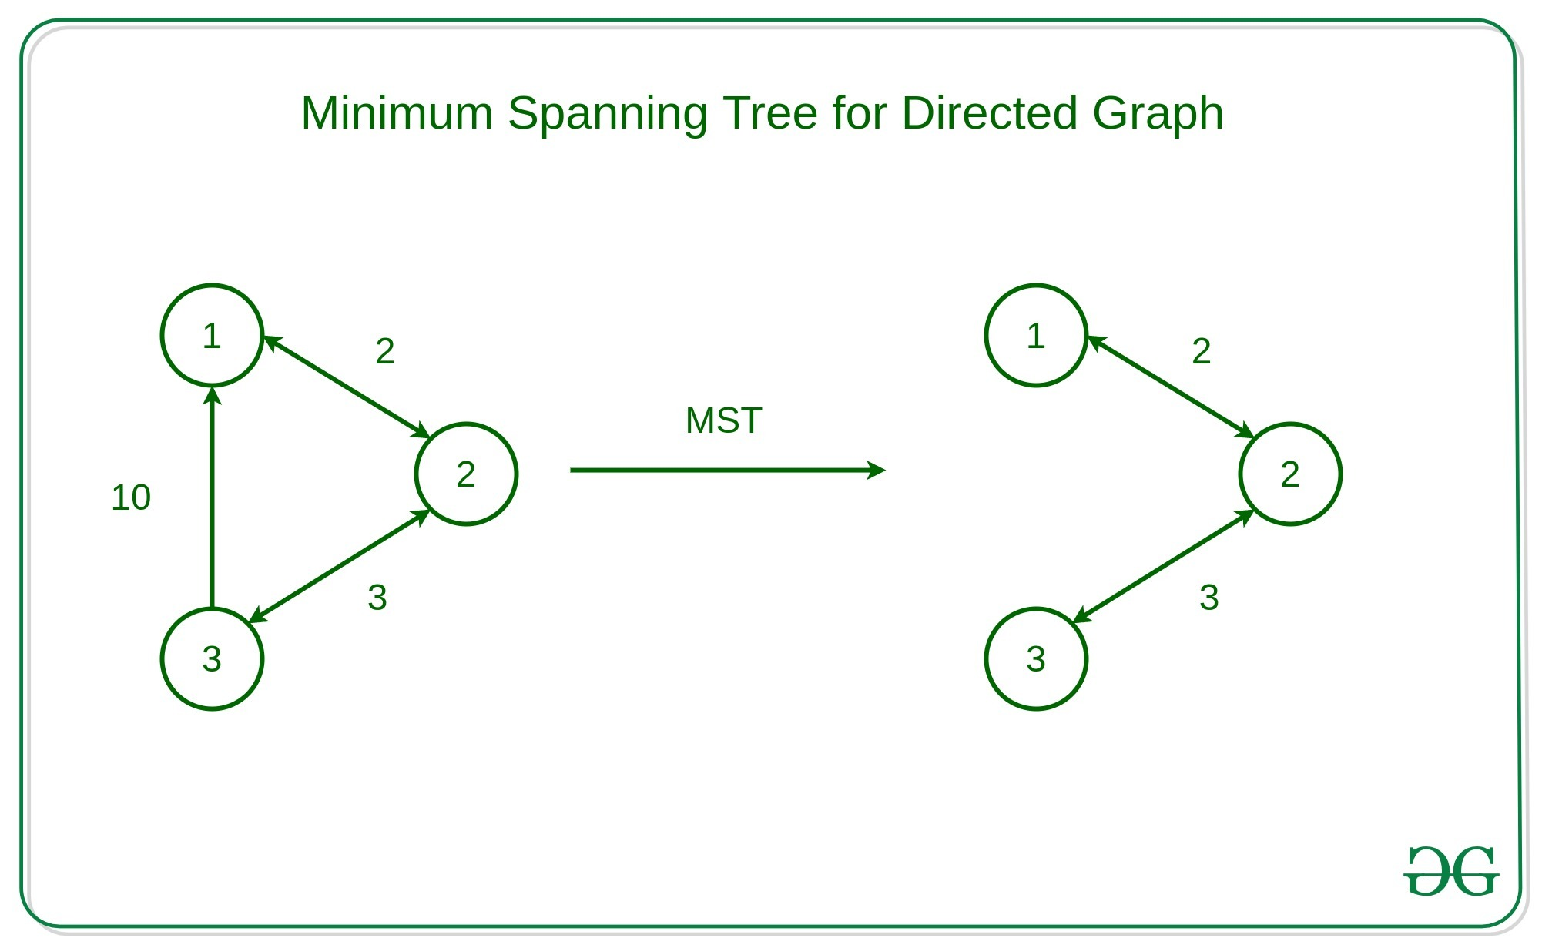
Minimum Spanning Tree (MST)
A minimum spanning tree (MST) is defined as a spanning tree that has the minimum weight among all the possible spanning trees
A spanning tree is defined as a tree-like subgraph of a connected, undirected graph that includes all the vertices of the graph. Or, to say in Layman’s words, it is a subset of the edges of the graph that forms a tree (acyclic) where every node of the graph is a part of the tree.

Slide 3
Kruskal's Algorithm for MST
It falls under a class of algorithms called greedy algorithms that find the local optimum in the hopes of finding a global optimum.
We start from the edges with the lowest weight and keep adding edges until we reach our goal.
The steps for implementing Kruskal's algorithm are as follows:
Sort all the edges from low weight to high
Take the edge with the lowest weight and add it to the spanning tree. If adding the edge created a cycle, then reject this edge.
Keep adding edges until we reach all vertices.

Slide 4
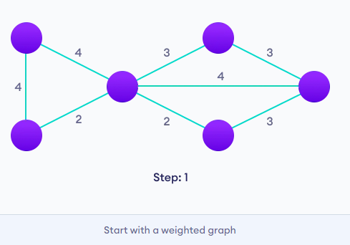
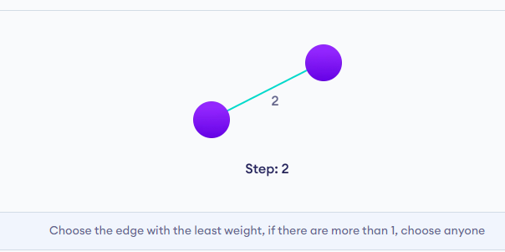
Example for Kruskal's Algorithm for MST

Slide 5
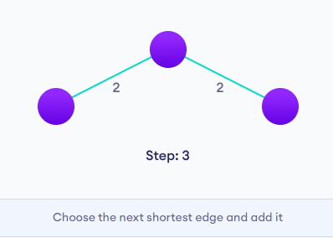
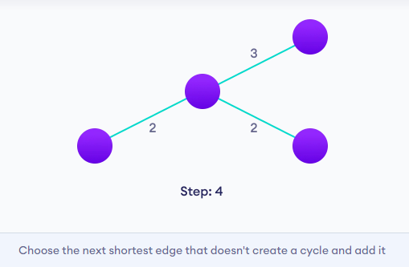
Example for Kruskal's Algorithm for MST (contd…)

Slide 6
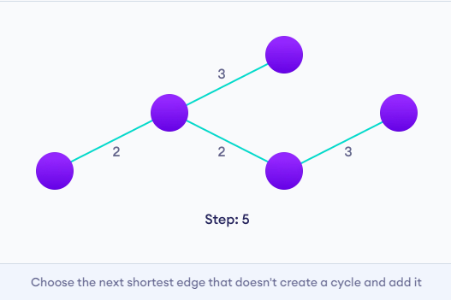
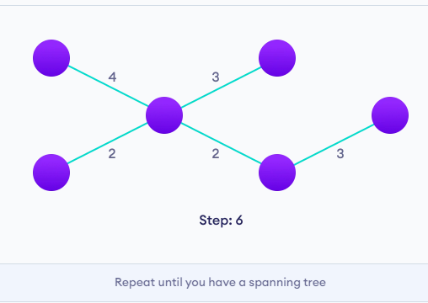
Example for Kruskal's Algorithm for MST (contd…)

Slide 7
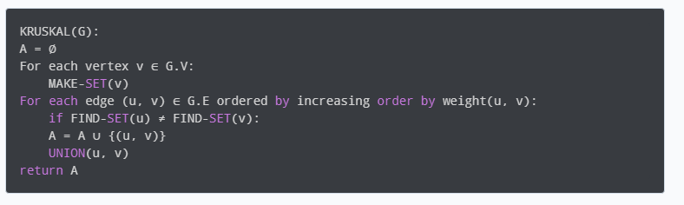
Pseudo code for Kruskal’s Algorithm

Slide 8
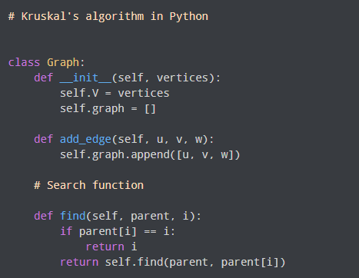
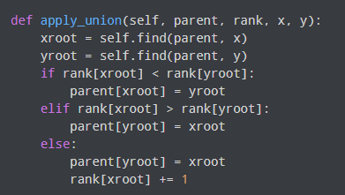
Implementation details of Kruskal’s Algorithm
Union function – combines two nodes
Find function – finds a parent of node

Slide 9
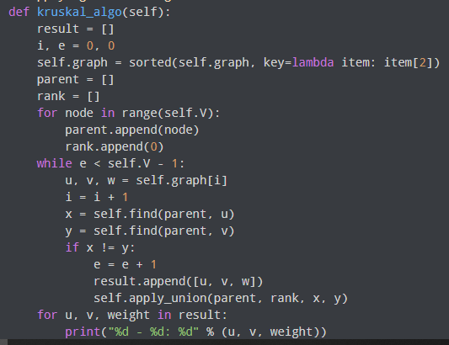
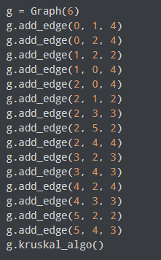
Implementation details of Kruskal’s Algorithm
Driver Code
For this e.g., the initial values are
Parent = [0, 1, 2, 3, 4, 5], Rank = [0, 0, 0, 0, 0, 0, 0]

Slide 10
Time complexity of Kruskal’s Algorithm
The time complexity of Kruskal's Algorithm is O(ElogE), where E is the number of edges in the graph. This complexity is because the algorithm uses a priority queue with a time complexity of O(logE). However, the space complexity of the algorithm is O(E), which is relatively high.

